Slide 1
GOSCIENCE TRAINING: ENHANCING COMPREHENSION IN SCIENCE EDUCATION
Enhancing reading comprehension of scientific texts
22-26 October 2018, Vidin, Bulgaria
2017-1-BG01-KA201-036209

Slide 2
Reading comprehension
Reading involves cognitive processes which enable readers to comprehend the meaning of a text by decoding printed symbols.
These multiple cognitive processes are not active at all times. There are two types of mental processes lower-level and higher-level processes, which are used depending on the type of the reading activity.:
Lower-level processes focused at the word level are skills which should become automatized during early education and are carried out unconsciously;
Higher-level processes are based on the overall interpretation of the text are developed throughout the reader’s life.
Reading comprehension is “intentional thinking during which meaning is constructed through interactions between text and reader. . . . The content of meaning is influenced by the text and by the reader’s prior knowledge and experience that are brought to bear on it” (Reutzel & Cooter, 2011).
Reading comprehension involves four components:
the reader
the text
the activity (e.g., discovering the author’s main idea, understanding a sequence of events, thinking about a character’s intent in a story, etc.)
the situational context or the actual setting where reading occurs (individual reading or a social activity in which people read the text together)

Slide 3
Schema theory
When reading, people use prior knowledge to comprehend and learn from text.
All our knowledge is organized and stored into acquired knowledge structures (schemas/schemata) like folders in a computer.
Such schemas (or schemata) are used like a mental framework/network to represent and organize information. The importance of schema theory to reading comprehension also lies in how the reader uses schemata.
Schemata enable us to recall, organize memory, focus attention, interpret experience, or try to predict most likely outcomes of events.
A text provides directions for readers as to how they should retrieve or construct meaning from their own previously acquired knowledge.
According to schema theory, comprehending a text is an interactive process between the reader’s background knowledge and the text. Efficient comprehension requires the ability to connect the text (reading passage) to one's own knowledge.
In the educational process teachers’ task would be to help students to develop new schemata and establish connections between them.

Slide 4
Levels of reading comprehension
We make meaning and comprehend in three ways (three levels of reading comprehension):
Readers make meaning through literal comprehension. We demonstrate understanding of what we have read by retelling and summarizing in our own words what has been made explicit – the facts.
Readers make meaning through inferential comprehension. We demonstrate understanding of what we have read by making inferences, interpretations, and reflections about what is implicit in the text. We do this supported by evidence from the text or by making connections to background knowledge and personal experience.
Readers make meaning through analytical comprehension; we see through the eyes of a writer, analyzing and evaluating the quality of the writing. We demonstrate understanding by identifying traits of good writing. In doing so, we improve our ability to write.

Slide 5
Strategies and techniques in developing reading comprehension
Setting a purpose for reading
Previewing the text to evaluate its relevance
Reading selectively
Associating the text with their prior knowledge
Evaluating hypotheses set during the initial preview
Underlining
Making notes
Paraphrasing
Guessing meaning of new words from the context
Rereading
Evaluating the texts
Reviewing the information after finishing
Applying the information learned

Slide 6
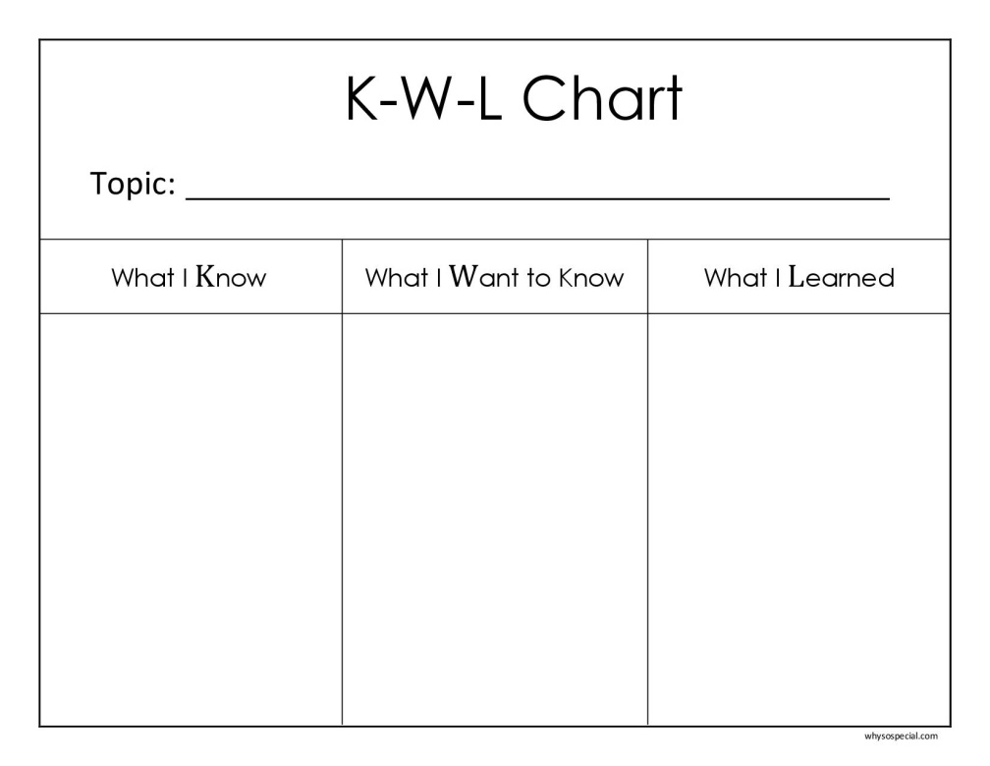
Strategies and techniques in developing reading comprehension: pre-reading activities
Quick Talk:
This activity can be used to activate prior knowledge and it is based on the idea that one of the best ways to consolidate knowledge is when we talk about it. Ask students to pair up, and then tell each other what they know about the topic you want to introduce.
K-W-L Chart :
It involves using a chart asking students to put down before they start reading text what they know about a topic and what they want to know, and complete the chart with what they learned at the end of the activity. Then ask students to share what was learned from that reading.

Slide 7
Strategies and techniques in developing reading comprehension: pre-reading activities
Two Column Notes: This activity asks students to respond to a text by organizing notes and thoughts into two columns. The left column is labeled “Key Ideas” and the right is labeled “Responses.” The “Key Ideas” section includes traditional notes from the text, like main ideas, details, people, and events. The “Responses” section is a place for students to record questions, inferences, assumptions, and connections they’ve made. By linking the key ideas with responses, students can better internalize the information from the text.
Anticipation/Prediction Guide:This activates prior knowledge and creates anticipation regarding new information. Choose the important concepts students have to gain by reading the text. Make four to six true or false statements based on the text. Have students decide on the statements and then read the text. After reading the text, discuss each statement with the class; compare students’ ideas with the author’s opinions.
Textbook scavenger hunt: Students receive a list of items to be found in their textbook; they must locate the items (e.g. table of contents, glossary, illustrations, charts etc.) and note the page on which the items were found. Discuss with them the method they used to find the information.

Slide 8
Strategies and techniques in developing reading comprehension: during-reading activities
Vocabulary Development: What does this word mean? Guessing from context refers to the ability to infer the meaning of an expression using the clues that the context provides. Write the sentence in which this word appears in the text. Based upon how it is used in the text, ask students to predict what the word means by reading the sentences round it. Then invite them to consult an “expert” (e.g., a friend, teacher, or dictionary) to find out the actual definition. Discuss with students ways to help them remember the meaning of the word (draw a picture of what the word means/ select and perform a miming action that the word reminds them of./ connect the word with something similar that they are familiar with).
Word Category. It is a simple and effective method for building student vocabulary. The idea behind this strategy is to help students make semantic connections between terms. First, students copy vocabulary terms (new and known) on cards, one word per card. Then, either individually or in groups, students put the words into categories (teacher’s or their own). Once they have finished, students discuss the reasoning behind the choices they made.

Slide 9
Strategies and techniques in developing reading comprehension: during-reading activities
Click or Clunk activity: This activity is especially useful in contextual reading. Students should ask themselves if they understand what they are reading, if the reading “clicks” for them or if it goes “clunk,” they do not understand it. If it clunks, they should ask the teacher questions to make sense of it.
Slow down: In science reading, students have a tendency to speed read. The students have to identify and write down the main idea of each paragraph they read. Then they have to compare their findings.
Making predictions: The purpose of this activity is to make predictions about the material to be read, and then refine these predictions while reading. Predict: Students reflect on what they think the text will be about by using clues such as the title, prior knowledge of the subject, or introductory explanations given by the teacher. Students put down their predictions.

Slide 10
Tools and practices using technology to enhance reading comprehension
Rewordifying Engine https://rewordify.com/helprewordifyingengine.php
It intelligently simplifies difficult English, for faster comprehension. The teacher pastes the text into a text box on the site. Rewordify then analyzes this text, and replaces complex words with simpler words to aid students’ understanding. Users can click on the replacement words to display either the original, more difficult language or individual words’ definitions.
Important Words https://tagcrowd.com
The tool can generate a visual representation of a text emphasizing the most important words in the selection (number of words used, common words). After reading the text, ask students to list the most relevant words. By identifying important words students can determine the main ideas and key details of academic texts.
More in the Research and Methodology for enhancing comprehension, developed under the project.

Slide 11
GOSCIENCE.EU
https://www.facebook.com/goscienceproject/
2017-1-BG01-KA201-036209

Slide 12
Thank you for your attention!
„This project has been funded with support from the European Commission.
This publication [communication] reflects the views only of the author, and the
Commission cannot be held responsible for any use which may be made of the
information contained therein.”

